Slide 1
SMART4ALL
An extensive network of Digital Innovation Hubs for boosting technology and business development in South, Eastern and Central Europe
Nikolaos Voros
University of Peloponnese
SMART4ALL Project Coordinator

Slide 2
SMART4ALL ID Card
DT-ICT-01-2019: Smart Anything low energy computing Everywhere – Area 2: Customized powering CPS and the IoT

Slide 3
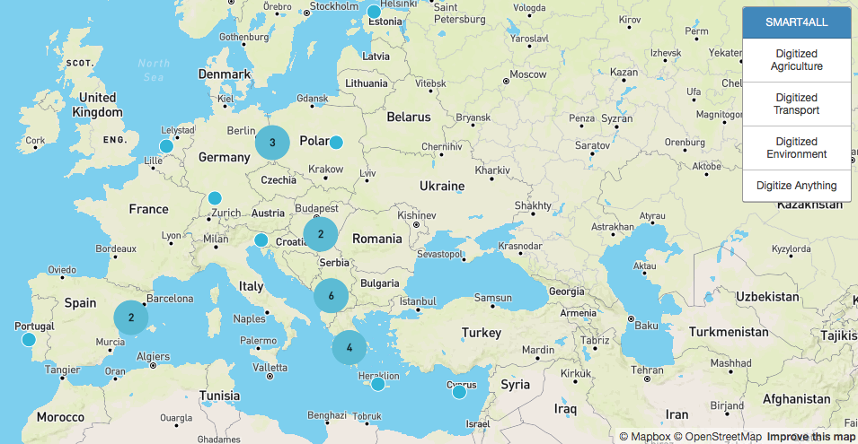
SMART4ALL Consortium
25 partners originated from South, Eastern & Central Europe
The consortium is composed of universities, research institutes, investors, networking organizations, SMEs, Innovation Hubs and NGOs

Slide 4
SMART4ALL in a Νutshell
Vision: To build capacity amongst European stakeholders by joining different cultures, different policies, different geographical areas and different application domains
How: Through the development of selfsustained, cross-border experiments that transfer knowledge and technology between academia and industry
Technological Areas: Customized low energy computing (CLEC) & IoT
Application Areas: Digitized Environment, Digitized Agriculture, Digitized Αnything and Digitized Τransport

Slide 5
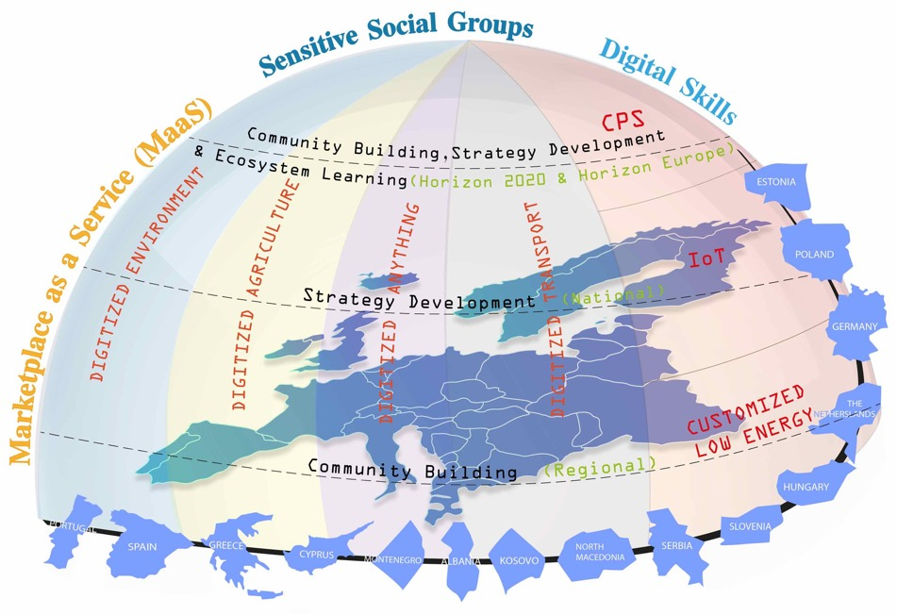
SMART4ALL Vision

Slide 6
SMART4ALL Objectives
Bring innovative Customized Low Energy Computing (CLEC) CPS and the IoT technologies to underrepresented business sectors
Unlock South-Eastern parties’ potentials through links to investors across value chains and regions in order to accelerate CLEC CPS/IoT solutions development and industrialization
Develop/offer novel tools to boost the use of CLEC CPS and the IoT technologies Europewide
To ensure post-project sustainability and growth of the SMART4ALL experiments & DIHs network
To bring innovative CLEC CPS and the IoT technologies in the lives of sensitive social groups
To support Digital Skills & Jobs policy of European Commission

Slide 7

SMART4ALL An Extensive Network of DIHs
An extensive network of Digital Innovation Hubs for boosting technology and business development in South, Eastern and Central Europe
Business Services:
Application oriented coaching for business development
Partner search and business matchmaking
Online training courses
Ecosystem Services:
Access to SMART4ALL network/ecosystem
Identify funding opportunities
  SMART4ALL Open Calls
  Local and European funding frameworks
Application oriented ethics coaching
Interconnection with other networks/ecosystems
Technological Services:
Application oriented technological coaching
Access to state-of-the-art infrastructures & services
Technological matchmaking
Online training courses

Slide 8
SMART4ALL PAE Types
PAE
Pathfinder Application Experiments
KTEs
Knowledge Transfer Experiments
FΤTEs
Focused Technology Transfer Experiments
CTTEs
Cross-domain Technology Transfer Experiments
Funding: 8K Euros
Type: Internship
Funding: 80K Euros
Type: Project
Funding: 80K Euros
Type: Project
Internal: 21 FΤTE (vertical) will be developed by SMART4ALL
External: 67 KTEs/FTEs/CCTEs will be developed via open call funding

Slide 9
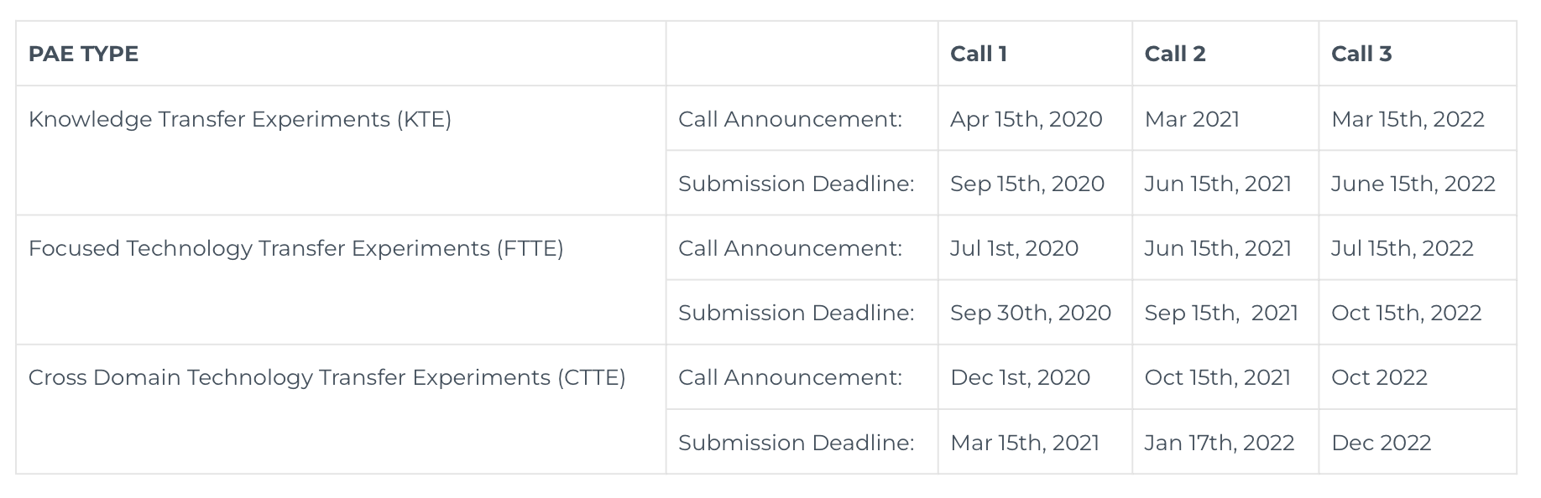
SMART4ALL PAE Cut Off Dates

Slide 10
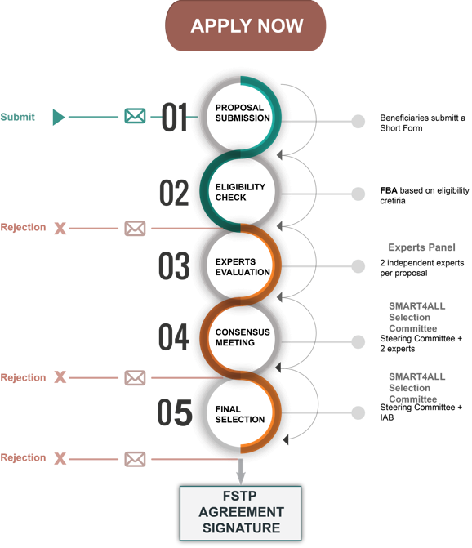
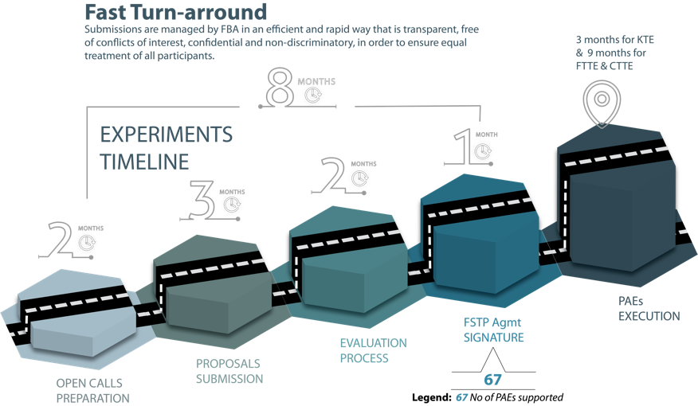
SMART4ALL PAE Application Stages

Slide 11
Open Call Statistics (6 open calls)
Applications by Country and Vertical
COUNTRIES (35 in total)
VERTICALS
4 February 2021
11

Slide 12
Open Call Statistics (6 open calls)
Allocation per call
PAEs funded
41 PAEs have been selected for funding with an overall amount of 1.480.000 €
25 Knowledge Transfer Experiments – 8K €. 200Κ in total
8 Focused Technology Transfer Experiments – 80K €. 640K in total
8 Cross-domain Technology Transfer Experiments – 80K €. 640Κ in total
356 proposals
4 February 2021
12

Slide 13

Join now SMART4ALL Network !
Join now SMART4ALL Network in South, Eastern and Central Europe by:
Subscribing to SMART4ALL newsletter:
https://smart4all-project.eu/joinus
Using SMART4ALL matchmaking services:
https://matchmaking.smart4all-project.eu
Applying to SMART4ALL Open Calls:
https://smart4all-project.eu/opencalls-apply-now
Employing SMART4ALL marketplace:
https://smart4all-project.eu/marketplace

Slide 14

SMART4ALL Social Media
Follow SMART4ALL on:
https://www.linkedin.com/groups/12369183
https://twitter.com/Smart_4All
https://www.facebook.com/SMART4ALL.Project
https://www.youtube.com/channel/UCwmSl9LCl2vNBO-3k75dvJA
… and stay up to date for the latest SMART4ALL news, activities & funding opportunities !

Slide 15
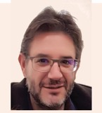

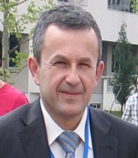
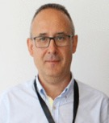
SMART4ALL Contact persons
Project Coordinator
Central Europe Contact
East Europe Contact
Prof. Nikolaos Voros
University of Peloponnese, Greece
Prof. Michael Huebner
Brandenburg University of Technology, Germany
Prof. Tamás Kovácsházy
Budapest University of Technology and Economics, Hungary
voros@uop.gr
huebner@b-tu.de
khazy@mit.bme.hu
Balkan Contacts
South Europe Contacts
Prof. Radovan Stojanovic
Mediterranean Excellence in Computing and Ontology, Montenegro
Prof. Fransisco Blanes
Polytechnic University of Valencia, Spain
pblanes@ai2.upv.es
stox@ac.me

Slide 16

Thank you for your attention – Questions?

